Slide 1
Workshop 1: linear regression
ML1

Slide 2
Hands-on assignments
Hands-on 5: Hands-on 5: deploy a pre-trained Keras model using Tensorflow.js
Hands-on 6: deploy a pre-trained model using Streamlit

Slide 3
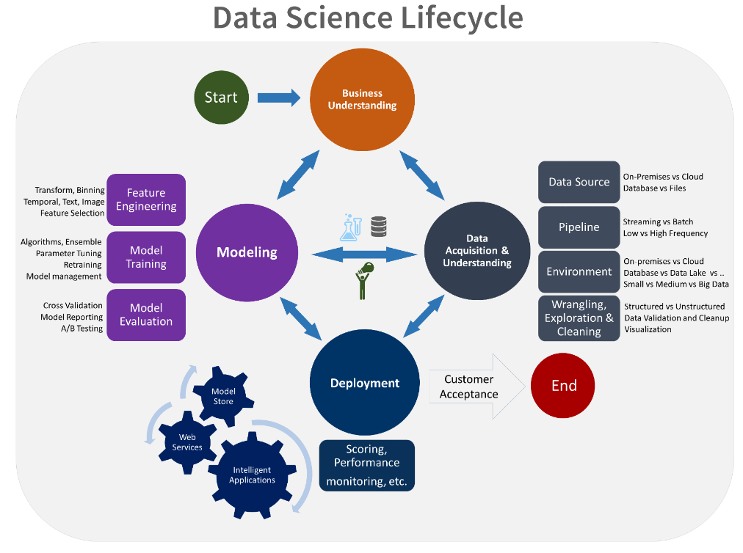
Deploying your ML model

Slide 4



ML model in backend
prediction request
trained keras/tensorflow ML model

Slide 5

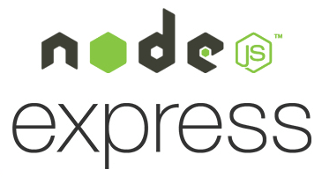
ML model in front-end
prediction request
trained keras/tensorflow ML model
file server

Slide 6

Python-based backend
prediction request
python-based
ML model
streamlit

